Slide 1

Online Scooty Shopping

Slide 2
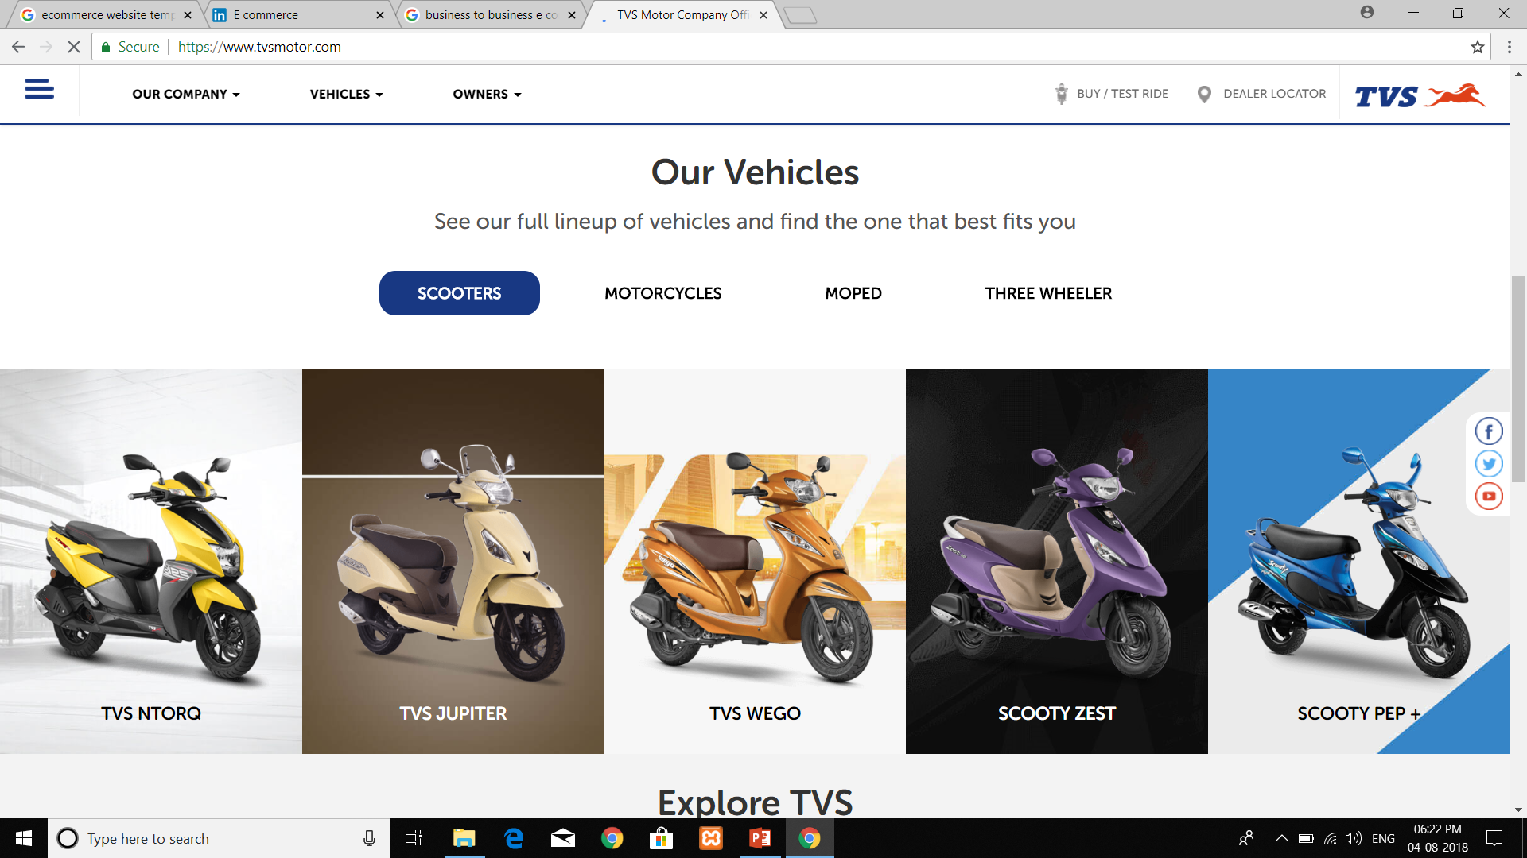
Our Vehicles
See our full line-up Of Vehicles and Find the one that best fits you.
SCOOTERS

Slide 3
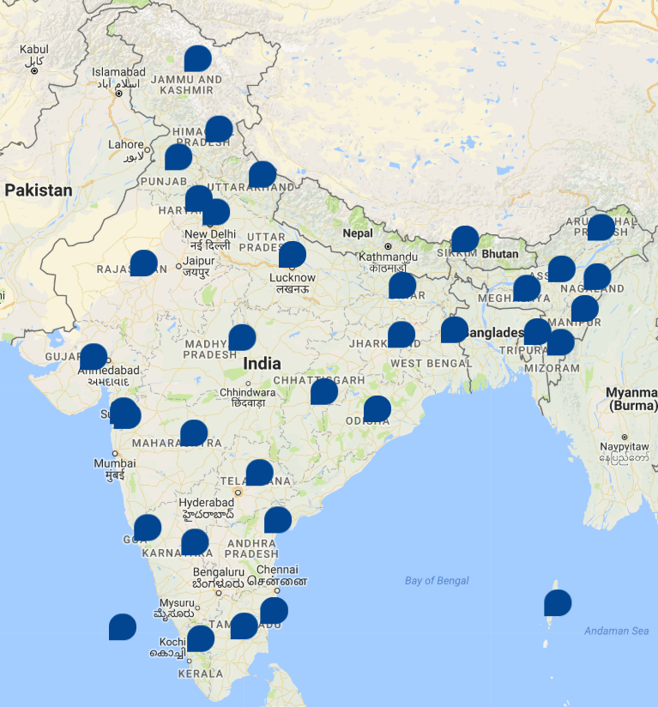
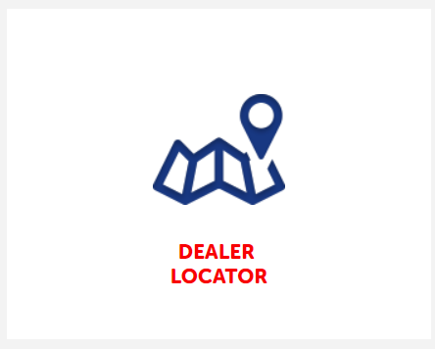
Dealer Locator
Dealer is an individual or firm who buys goods from a producer or distributor for wholesale or retailing. Dealer Locator is a person who locates him on behalf of the company.
This will come under Route to market. When a company enters a market, it does enough research to find out about all the possible dealers in the locality. They do screening and then they suspect, prospect, approach, negotiate, close the deal, order, payment. These processes help the company in locating the correct dealer according to company values.

Slide 4

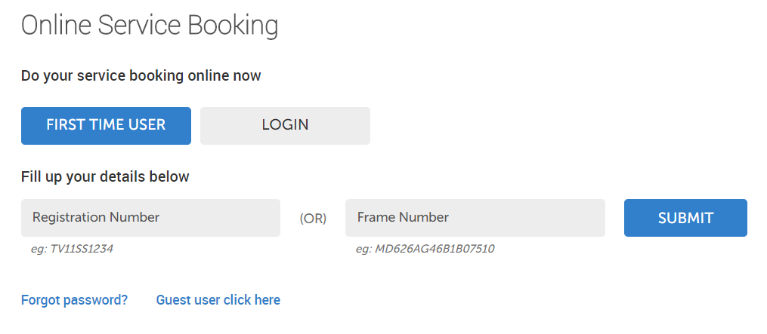
Online Service Booking
Our Company will provide you with booking service form your valuable time , Our reputation for reliability is complemented by the quality of service we offer. We help you make the most out of our service programs that are considered to be excellent.

Slide 5
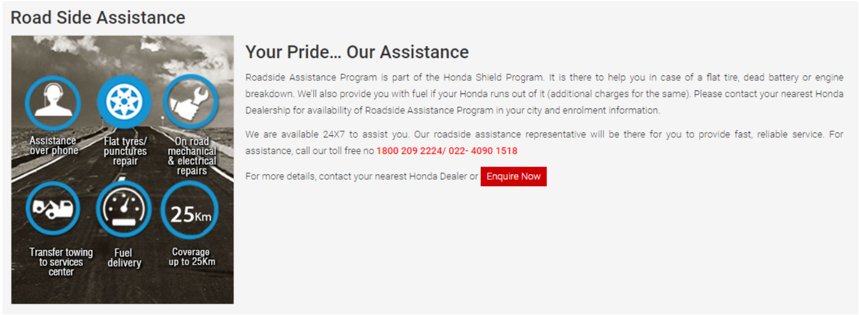
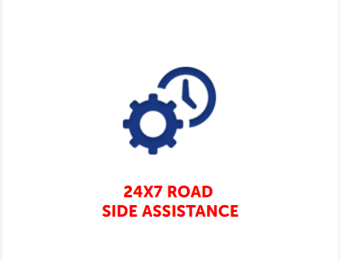
24x7 Road Side Assistance
To increase Customer Mobility, Our Company has introduce ROADSIDE ASSISTANCE (RSA) Program in India. We have tied up with TVS Auto Assist (India) Limited, to ensure that you get quick and hassle-free service in the event of any unexpected breakdown of your vehicle.
In the event of any mechanical or electrical breakdown/traffic accident of your vehicle, all you have to do is call our Toll free number 1800 258 7111 to avail this Roadside Assistance Service- 24X7, 365 days.

Slide 6
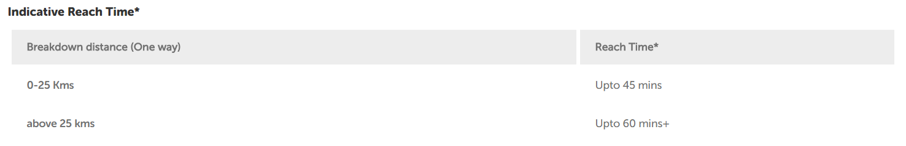
This service will be provided to all 2 Wheelers either free of cost or at a reasonable cost to customers, depending on date of sale of vehicle & models covered.
Free of Cost (FOC) : All Scooters sold before or after the date of launch of the program in the town shall be covered for first two years from the date of sale.
Chargeable Basis : For Scooters out of primary warranty, customers can avail the facility by paying a service charge at the time of availing the service. No separate membership fee required.

Slide 7
What Services under RSA? Our Company will assign one authorized technician (Executive) who will be in touch with the customer to provide the following support :
Onsite Repair - Support regarding Minor Mechanical/ Electrical will be provided to get the vehicle road-worthy
Flat Tyre Support - In case of a puncture or tyre burst, the assigned executive shall support the Customer in getting it repaired from the nearest Tyre Repair Shop.
Fuel Delivery - In the event of the vehicle running out of fuel while traveling, the assigned executive will provide support by arranging up to 2 liters of fuel. The supply of fuel will be based on availability and fuel charges shall have to be borne by Customer.
Key Loss Support - Customers can also avail the pick-up of replacement key from the house of customer in case the key is lost.
Assistance in Case of Accident - In the undesired event of an accident, the customer will be provided information related to medical facilities available nearby. The vehicle will be towed to the nearest workshop on completion of legal formalities if any.
Towing Assistance - In the unlikely event where the vehicle could not be made roadworthy on the site, customers can still avail the service of towing the vehicle to the nearest Company Authorized Dealership.

Slide 8
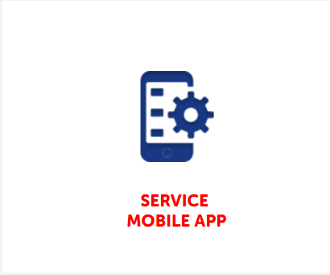
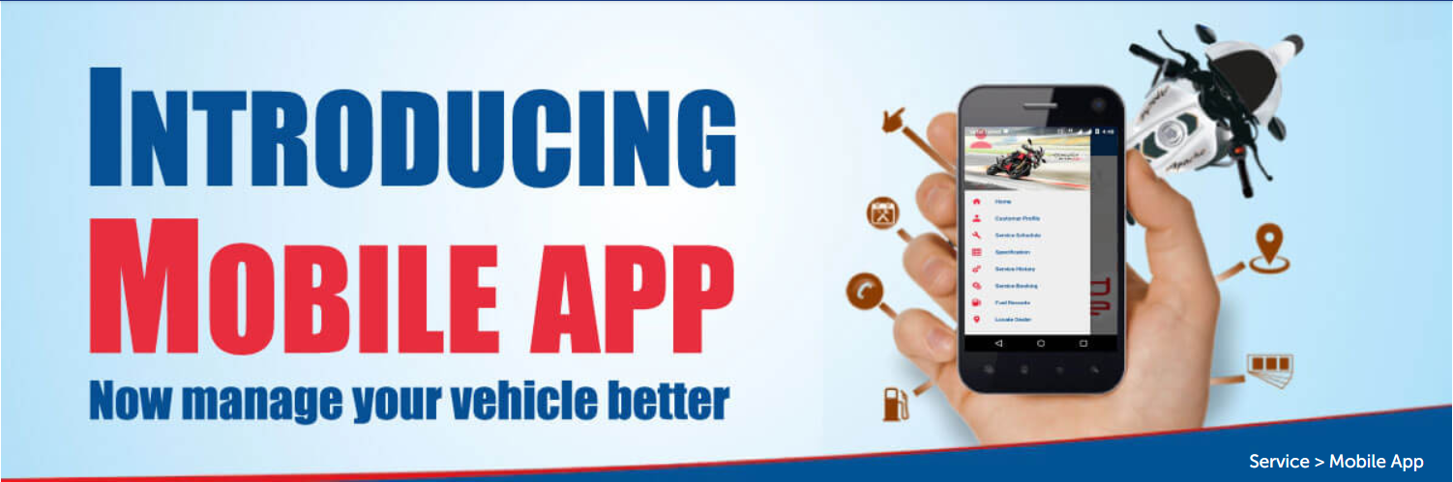
Service Mobile App
Our Company has released 2nd version of service mobile app on 8th aug’19 to deliver an enhanced experience for its customers, fulfilling three key objectives which are as follows:
Availing our services will now become more convenient : The app reduces the time and the effort with which the customer can obtain relevant information regarding his vehicle (specifications, warranty, service history)and now on a click can avail the services on offer by our company such as service booking, roadside assistance etc..
The app will keep our customers updated about the company, our upcoming products and provide tips - to get best performance from their vehicles.
Connect us with each and every customer : Customers can now instantly connect both with our dealers and company to avail information/ services through features such as service feedback, contact us and dealer locator.

Slide 9
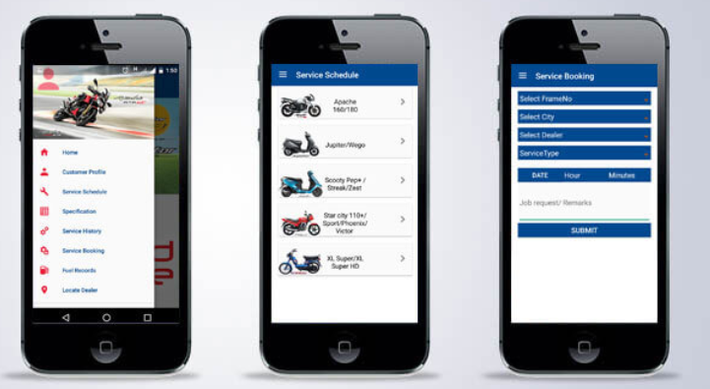
The App has been developed keeping in mind, customers’ busy schedule and higher accessibility to digital world.
Key features of this App :
Customer Profile : Customers can create a unique login and get all the required information about their vehicles.
Service Schedule : Customers can know the recommended service interval with respect to both Time and KM for their vehicles.
Specification : Details related to Engine, Electrical, Tyres, and Brakes are visible for every model which will help customers to take an informed decision.
Service Booking : Customers can book their service online by taking an appointment at their preferred dealership. Currently service booking facility is available at selected 120 dealerships across India.
Warranty : Customers can know more about their vehicle warranty terms and conditions at ease.
News & Updates : This feature provides latest information & updates related to TVS Motor.
Service History : This features enables user to know the vehicle service history. Customer can also rate their last service experience with TVS Motor.
Locate Dealer : With this feature TVS dealerships can be located by the App user using their current location through GPS.
Tips : Useful tips are available for customers to get better mileage from vehicle. Vital safe riding tips have also been provided.
Contact us : Contact details of TVS Motor are provided for customer support.

Slide 10

Search A Product
It is an important aspect as it helps a user in searching any product which he/she needs directly instead of exploring the whole website. For searching, a user enters the required product name and the product with some related products come down in the form of list.
The searching uses the AJAX technology, which is renowned for the method of exchanging data with a server and updating parts of webpage without reloading the entire page.

Slide 11
Ajax Search
Ajax Search allows users to search products in real time.
It helps to improve user experience, which indirectly improve sales.
It creates a simple search box that shows users the instant search results.
Users can just enter a keyword for the product they are looking for and Ajax Search will spare them the nuisance to browse all categories one at a time

Slide 12
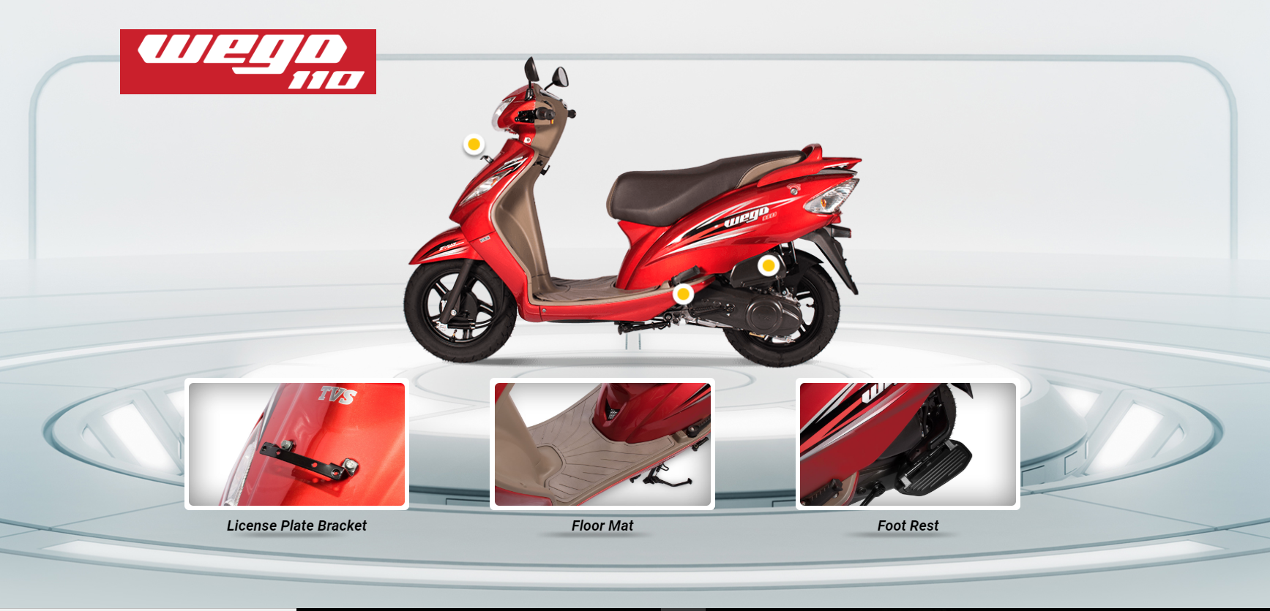
Featured Accessories

Slide 13

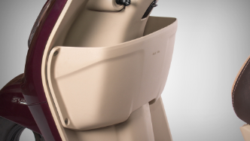
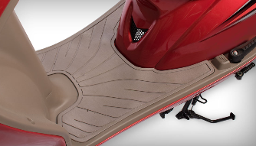
GLOVE BOX JUPITER-K6224450 MRP ₹233.00
FLOOR MAT
WEGO-K6220840
MRP ₹381.00

Slide 14



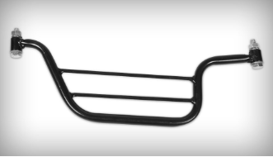
LICENSE PLATE BRACKET
CODE-K6221110
MRP ₹39.00
STUDDS HELMET
CODE-K63222108FBL
MRP ₹899.00
CRASH GUARD
SPORT-N83000305D
MRP ₹195.00
LADY PILLION FOOT REST
STAR CITY-N9223970
MRP ₹153.00

Slide 15
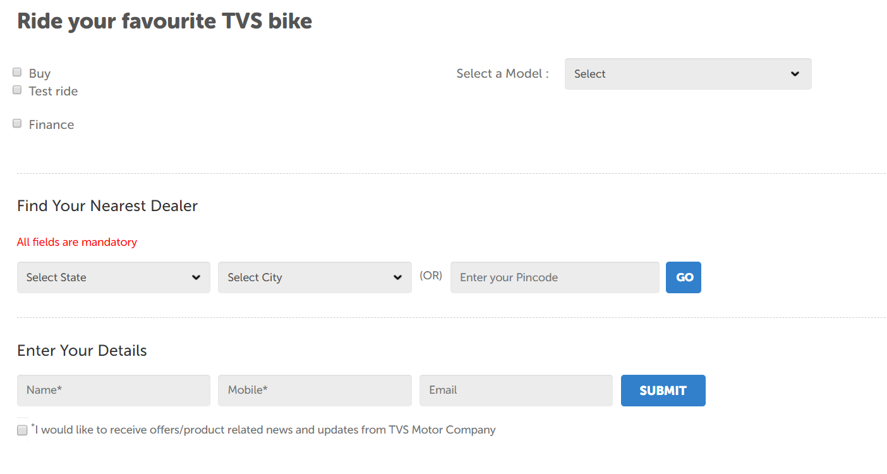
Buy/Test Drive

Slide 16
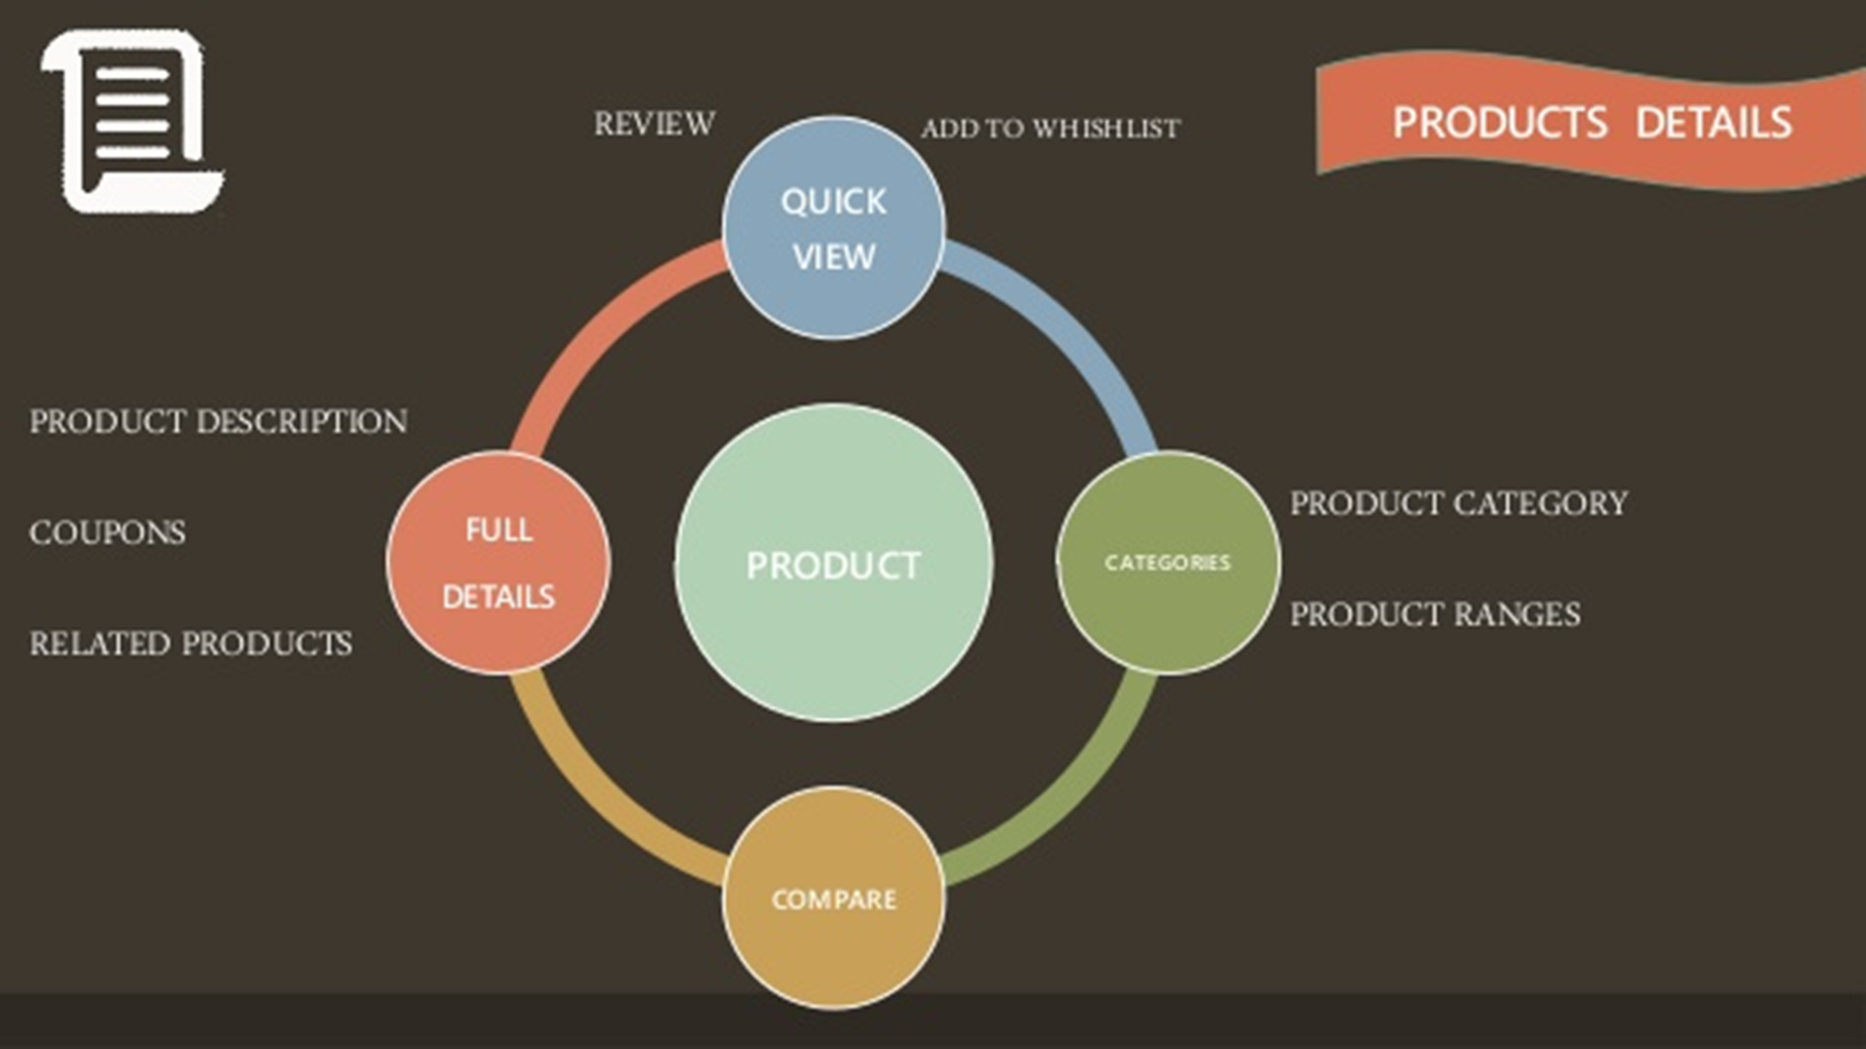
Products Details

Slide 17
Cart Details
User can simply add a product to cart the cart so that when he want to order different types of items he can view all those items in his cart and order them. User can also vary the count of number of items.
PRODUCT NAME
QUANTITY
COST
REMOVE ITEM

Slide 18

Order Tracking
An easy tool to manage order shipping information of the shop and to notify the customers about the shipping.
Useful tool to make shop as complete as possible and offer our customers the best services.

Slide 19

Live Chat
An exceptional plugin to make clients feel comfortable as in a physical shop.
Can ask for information and get immediate feedback.
Users need human contact and live chat can help them in overcoming the obstacles of the purchase doubts.
Customization of the messages(Welcome, greetings, offline, busy operations).
Availability of different tabs, multiple chats.

Slide 20
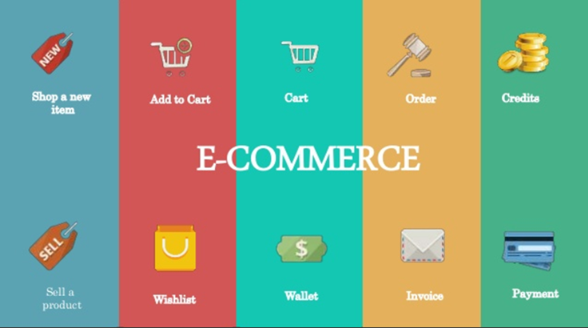
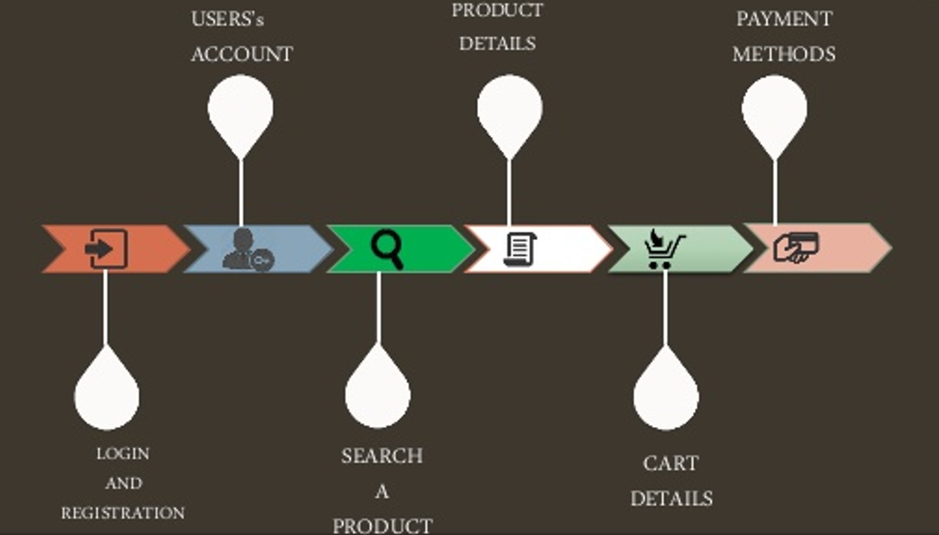

Slide 21
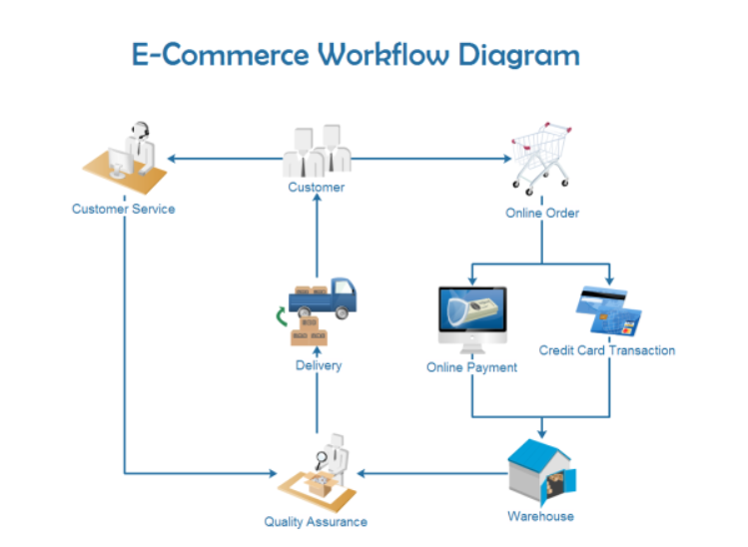
Business-to-Business
B2B e-commerce is simply defined as e-commerce between companies. This is the type of e-commerce that deals with relationships between and among businesses.
About 80% of ecommerce is of this type, and most experts predict that B2B e-commerce will continue to grow faster than B2C segment.
The B2B market has two primary components:
E-frastructure
E-markets
For example, a tire manufacturer might sell a car manufacturer.

Slide 22
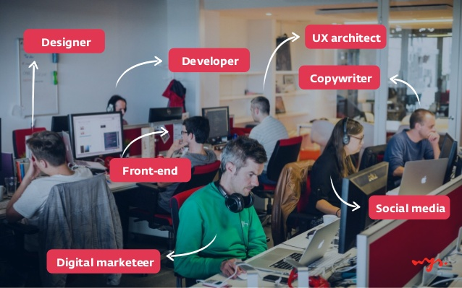
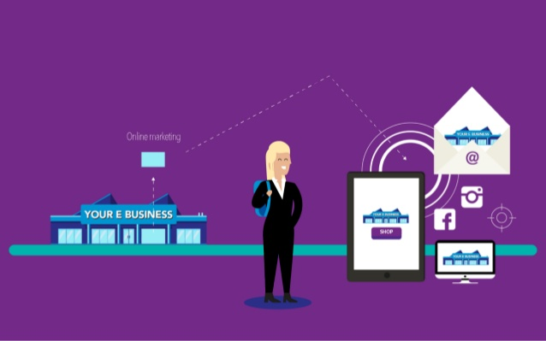

Slide 23

THANK YOU !

